Slide 1
Module 2 Active Directory Threats Landscape
Section 5 - Security Solution Tools
June 2018

Slide 2
Agenda
01
Azure Security Center Amongst all the features of Azure Security Center, we will have a look at the log collection capability.
02
Microsoft ATA This is an on-premises solution to monitor Active Directory identity and suspicious network activities.
03
Azure ATP for Users The cloud-based version of Microsoft ATA. We will look at its additional value.

Slide 3
ASC
Azure Security Center
Azure Security Center is a centralized glass panel
It does a lot of things
It consolidates the output of Azure connected security solutions (ie. Azure AD Identity Protection)
It checks the configuration of VMs hosted in Azure
It makes improvement recommendations
And it is also a way to collect and centralize event logs
Requires an agent installed on the systems to monitor (on domain controllers for example)
Stores the data in Azure Log Analytics (easy to query)
Collects and alerts for some specific activities
It comes with a list of events and correlations of events which will generate alerts
Notes:
What is ASC?
Centralized policy management – Ensure compliance with company or regulatory security requirements by centrally managing security policies across all your hybrid cloud workloads.
Continuous security assessment – Monitor the security of machines, networks, storage and data services, and applications to discover potential security issues.
Actionable recommendations – Remediate security vulnerabilities before they can be exploited by attackers with prioritized and actionable security recommendations.
Advanced cloud defenses – Reduce threats with just in time access to management ports and whitelisting to control applications running on your VMs.
Prioritized alerts and incidents - Focus on the most critical threats first with prioritized security alerts and incidents.
Integrated security solutions - Collect, search, and analyze security data from a variety of sources, including connected partner solutions.
Azure Security Center is free. But many of its features follow a “pay as you go” model. If you want to use ASC to collect event logs, there is a fee per monitored node.

Slide 4
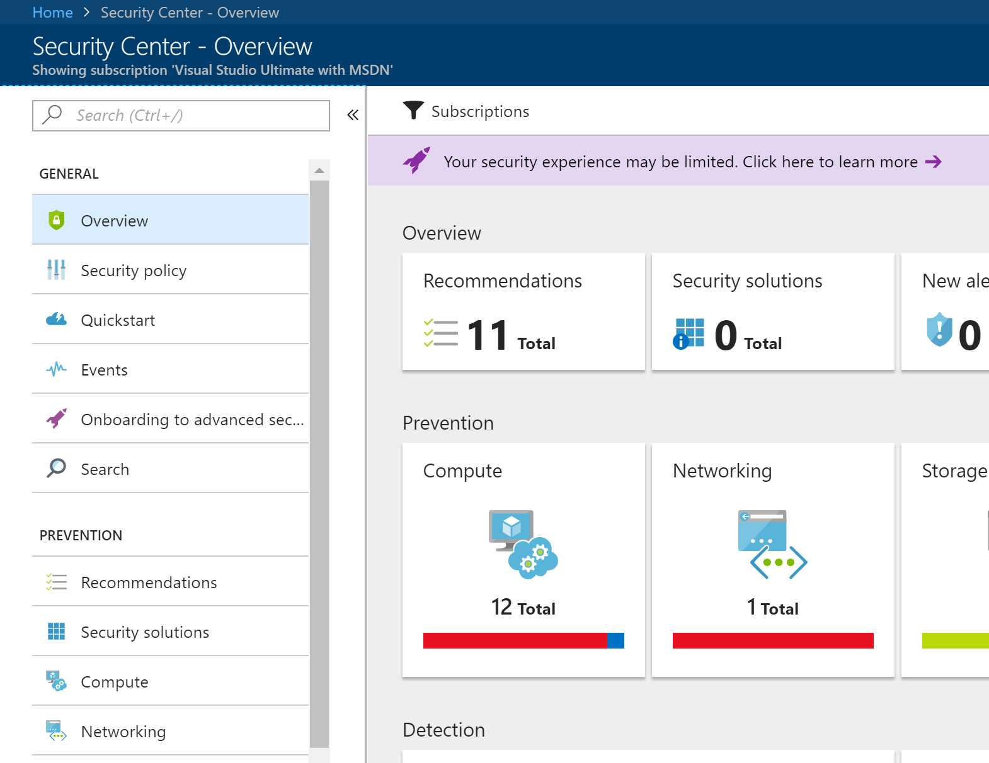
Azure Security Center
We are talking about these options…
We are talking about these options…
Notes:
If you install the agent just for event log collection, you still get the other detection capabilities (such as missing updates reports and security configuration recommendations).

Slide 5
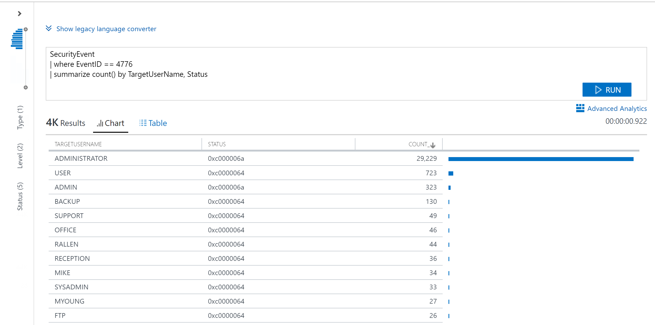
Azure Security Center Screenshot
Notes:
Note that by default ASC agents do not collect all the events but just the minimal to enable its built-in detection capabilities.
You might need to enable the full security vent log collection to perform advanced searches and event correlations in your environment. And there might be an extra in price since by default the data limit is 500Mb per node.

Slide 6
.
Video
Video Placeholder
This slide has to be watched with PowerPoint
Notes:
During this video you can see:
An Azure security operator searching for specific events

Slide 7

Azure Security Center
You can also connect Microsoft ATA
Send ATA alert to ASC and use a single alerting system
Can integrate with third party SIEMs
Notes:
Ref: Azure Security data export to SIEM- Pipeline Configuration [Preview] https://docs.microsoft.com/en-us/azure/security-center/security-center-export-data-to-siem

Slide 8
UEBA
Security Information Event Management vs User and Entity Behavior Analytics
Category | SIEM | UEBA
APT detection
Compromised credentials
Alert volume
Log aggregation
Compliance monitoring
Resource intensive
☹
😐 to ☺
☹
☺
☹
☺
☺
☹ to 😐
☺
☹
☹
😐 to ☺
Notes:
SIEMs are important. But they don’t cover all the specter of what an organization needs in term of security monitoring.
This is why User and Entity Behavior Analytics is key to improve one’s security posture.

Slide 9
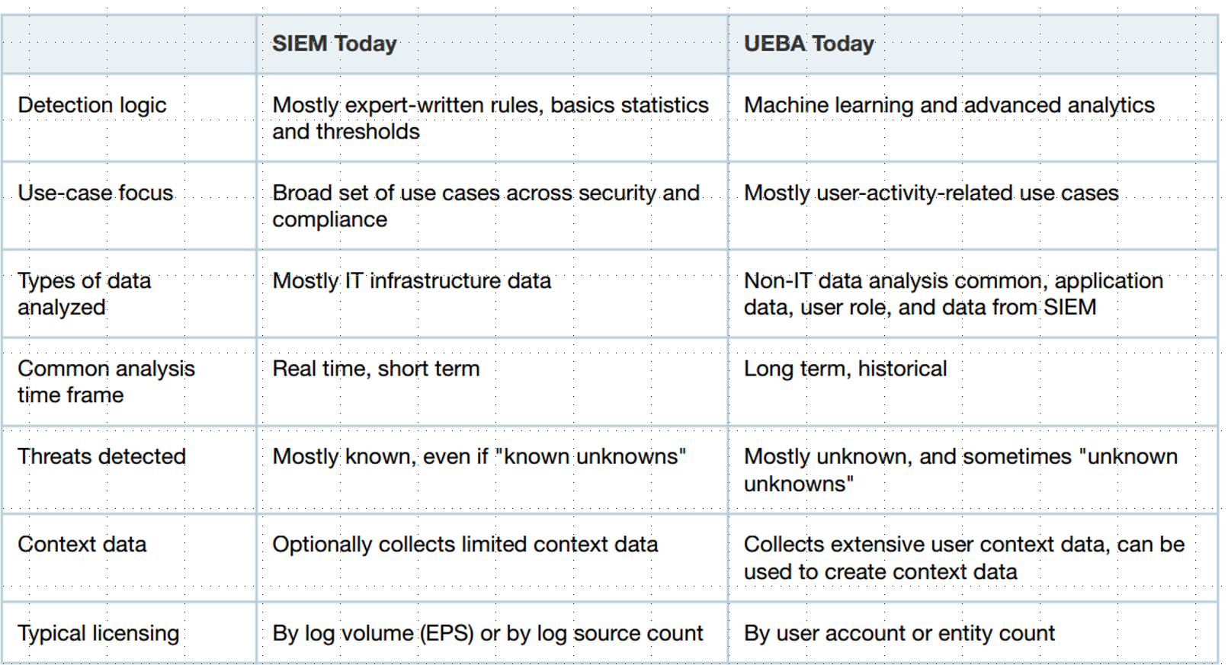
Security Baselines
Notes:
Source Gartner March 2017

Slide 10



Microsoft Advanced Threat Analytics
Behavioral Analytics
Detection of advanced attacks and security risks
Advanced Threat Detection
Microsoft Advanced Threat Analytics brings the behavioral analytics concept to IT and the organization’s users.
Notes:
An on-premises platform to identify advanced security attacks and insider threats before they cause damage.
Monitors behaviors of users and other entities by using multiple data sources
Profiles behavior and detects anomalies by using machine learning algorithms
Evaluates the activity of users and other entities to detect advanced attacks

Slide 11


Microsoft ATA
Abnormal resource access
Account enumeration
Net Session enumeration
DNS enumeration
SAM-R Enumeration
Abnormal authentication requests
Abnormal resource access
Pass-the-Ticket
Pass-the-Hash
Overpass-the-Hash
Skeleton key malware
Golden ticket
Remote execution
Malicious replication requests
Abnormal Modification of Sensitive Groups
Compromised Credential
Privilege
Escalation
Reconnaissance
Lateral Movement
Domain
Dominance
Abnormal working hours
Brute force using NTLM, Kerberos, or LDAP
Sensitive accounts exposed in plain text authentication
Honey Token account suspicious activities
Unusual protocol implementation
Malicious Data Protection Private Information (DPAPI) Request
MS14-068 exploit (Forged PAC)
MS11-013 exploit (Silver PAC)

Slide 12
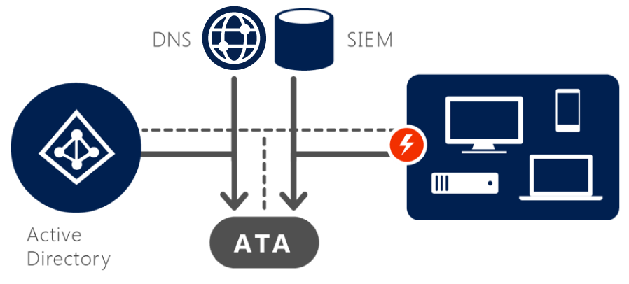
How Microsoft Advanced Threat Analytics works
Analyze
After installation:
Simple non-intrusive port mirroring, or deployed directly onto domain controllers
Remains invisible to the attackers
Analyzes all Active Directory network traffic
Collects relevant events from SIEM and information from Active Directory (titles, groups membership, and more)
Notes:
The ATA system continuously goes through four steps to ensure protection:
Step 1: Analyze
After installation, by using pre-configured, non-intrusive port mirroring, all Active Directory-related traffic is copied to ATA while remaining invisible to attackers. ATA uses deep packet inspection technology to analyze all Active Directory traffic. It can also collect relevant events from SIEM (security information and event management) and other sources.

Slide 13
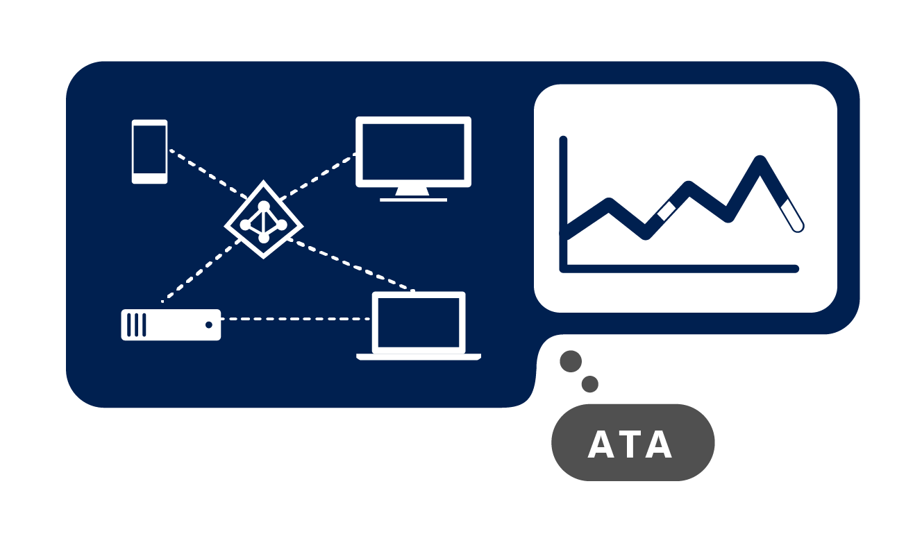
How Microsoft Advanced Threat Analytics works
Learn
Automatically starts learning and profiling entity behavior
Identifies normal behavior for entities
Learns continuously to update the activities of the users, devices, and resources
Notes:
Step 2: Learn
ATA automatically starts learning and profiling behaviors of users, devices, and resources, and then leverages its self-learning technology to build an Organizational Security Graph. The Organizational Security Graph is a map of entity interactions that represent the context and activities of users, devices, and resources.

Slide 14
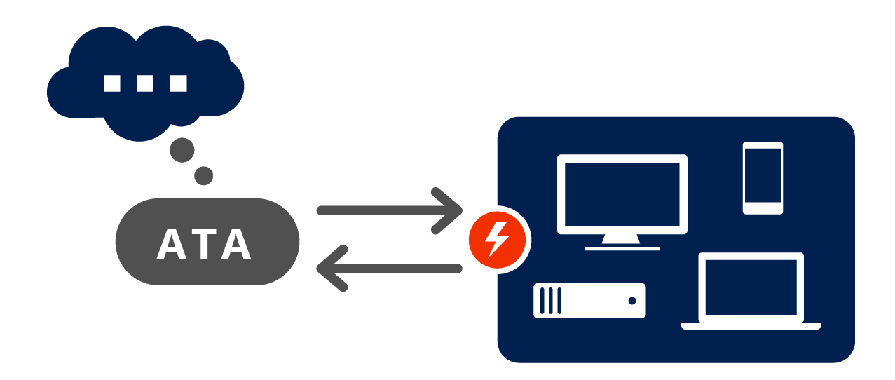
How Microsoft Advanced Threat Analytics works
Detect
Looks for abnormal behavior and identifies suspicious activities
Only raises red flags if abnormal activities are contextually aggregated
Leverages world-class security research to detect security risks and attacks in near real-time based on attackers Tactics, Techniques, and Procedures (TTPs)
ATA not only compares the entity’s behavior to its own, but also to the behavior of entities in its interaction path.
Notes:
Step 3: Detect
After building an Organizational Security Graph, ATA can then look for any abnormalities in an entity’s behavior and identify suspicious activities—but not before those abnormal activities have been contextually aggregated and verified. ATA leverages years of world-class security research to detect known attacks and security issues taking place regionally and globally. ATA will also automatically guide you, asking you simple questions to adjust the detection process according to your input.

Slide 15

How Microsoft Advanced Threat Analytics works
Alert
ATA reports all suspicious activities on a simple, functional, actionable attack timeline
ATA identifies
Who?
What?
When?
How?
For each suspicious activity, ATA provides recommendations for the investigation and remediation
Notes:
While the hope is that this stage is rarely reached, ATA is there to alert you of abnormal and suspicious activities. To further increase accuracy and save you time and resources, ATA doesn’t only compare the entity’s behavior to its own, but also to the behavior of other entities in its interaction path before issuing an alert. This means that the number of false positives are dramatically reduced, freeing you up to focus on the real threats.
At this point, it is important for reports to be clear, functional, and actionable in the information presented. The simple attack timeline is similar to a social media feed on a web interface and surfaces events in an easy-to-understand way

Slide 16
.
Video
Video Placeholder
This slide has to be watched with PowerPoint
Notes:
During this video you can see:
An ATA operator looking at the simplified attack timeline and drilling down to the details of an account involved in a suspicious activity
An ATA operator creating an exception for a detected risk

Slide 17





Topology
ATA GATEWAY 1
SIEM
://
DNS
Port mirroring
Fileserver
Syslog forwarding
DC1
DC2
INTERNET
ATA CENTER
DMZ
DC3
ATA Lightweight Gateway
DC4
VPN
DB
Fileserver
Web
Notes:
ATA may be deployed by either using port mirroring with the domain controllers, or the ATA Lightweight Gateway may be deployed to the domain controllers itself. The ATA Gateway is performing deep packet inspection on the traffic to and from the domain controllers looking for known attacks. ATA also uses the network traffic to learn which users are accessing which resources from which computers. ATA also makes LDAP queries to the domain to fill in user and device profiles. The user account used by ATA only requires read-only access to the domain.
If you are collecting Windows Events to a central SIEM / Syslog server, ATA can be configured from these systems. This additional information source helps ATA in enriching the attack timeline.

Slide 18
Azure Advanced Threat Protection for Users
It is the cloud-based version on Microsoft ATA
You don’t need to manage the ATA center and its database as it is in the cloud
It scales better (Microsoft takes care of the infrastructure)
It is connected to other ATP products in the Azure cloud
Microsoft manages the updates (it gets updated very frequently in comparison to ATA)
Notes:
Monitor your on-premises Active Directory with a convenient cloud service
Reduce strain and cost in your on-premises environment with analytics done in the cloud
Scale your anomalous behavior detections with the power of the cloud
Pivot to and remediate a malicious attack in Windows Defender ATP
Deploy with ease into your existing infrastructure
In term of licensing, this comes with an E5 license.

Slide 19










Azure ATP Architecture
Port mirroring
Domain Controller
Azure ATP Sensor
Domain Controller
Windows Event Forwarding
Azure ATP
Standalone
Sensor
Parsed network traffic from DCs
Alert notifications to SIEM
SIEM
Events
Azure
ATP
Access to console
Workspace Management
Workspace portal
Windows Defender ATP
Alert notifications
Notes:
It follows the same logical architecture as ATA. There is a no agent to install, but a “sensor”. It is a re-written on-premises ATA agent and has a minimal impact on performance.

Slide 20
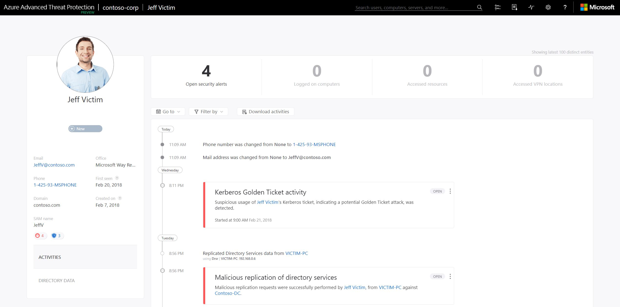
Azure ATP screenshot

Slide 22
List of abbreviations
ASC Azure Security Center
UEBA User and Entity Behavior Analytics
ATA Advanced Threat Analytics

